Slide 1
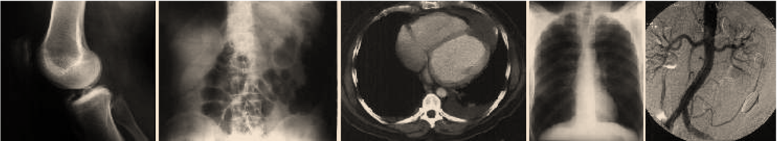
Medical Imaging
Source: uhrad.com.
Research in Medical Imaging
Elsa Angelini, PhD

Slide 2
Research in Medical Imaging
Topics
  Improve image quality.
  Extraction of organ contours.
  Quantitative measures on organs (volume, cardiac function, deformations, contractility,…).
  Modeling of organs, building of shape atlases.
  Validation of image information for diagnosis.
  Quantification of pathologies (eg. Tumors)
  Functional analysis, neuroscience.
Tools:
  Computers, mathematics, programming,anatomy biology, physics, clinical studies.

Slide 3


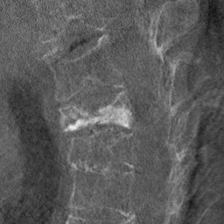


Research in Medical Imaging
Example: Denoising of 3DRX spine study
Original
Gaussian filtering
Denoising Application
Wavelet Thresholding
Adaptive Wavelet Thresholding

Slide 4
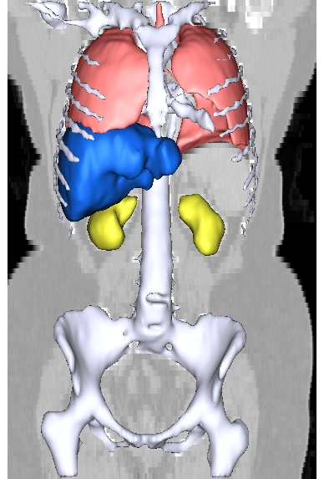
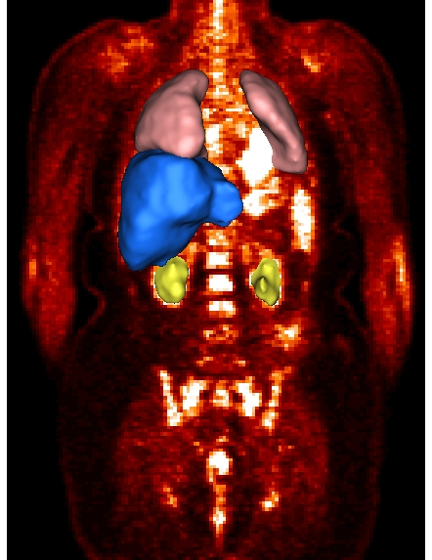
Research in Medical Imaging
Example: Registration of MRI and PET abdomen images

Slide 5
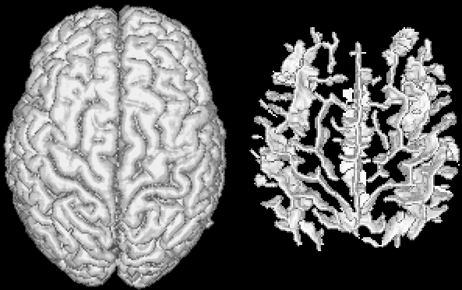
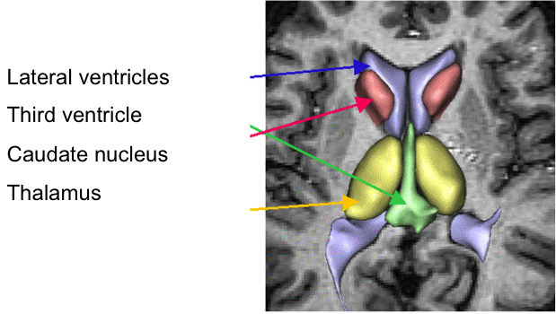
Research in Medical Imaging
Example: Segmentation of cortical brain structures

Slide 6
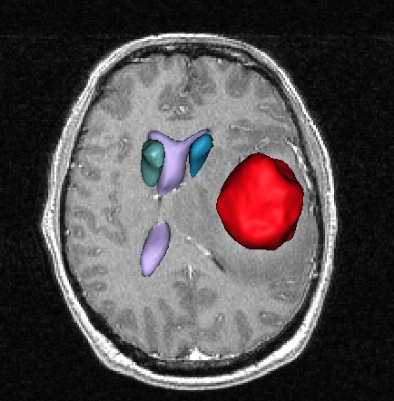
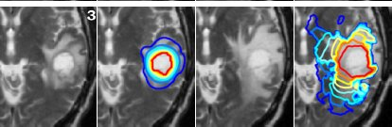
Research in Medical Imaging
Example: Segmentation of a tumor and deformed structures
Source: inria-sop.fr

Slide 7
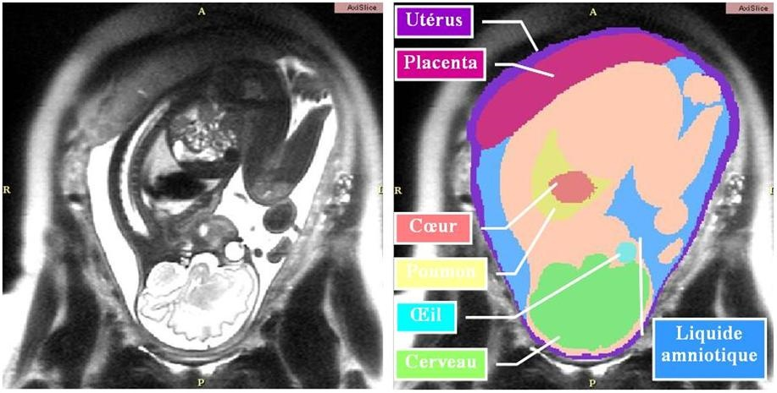
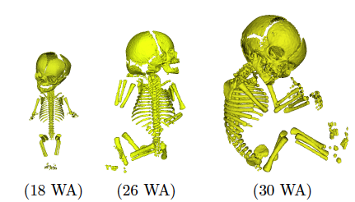
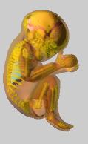
Research in Medical Imaging
Example: Fetal Imaging

Slide 8
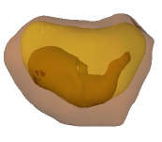
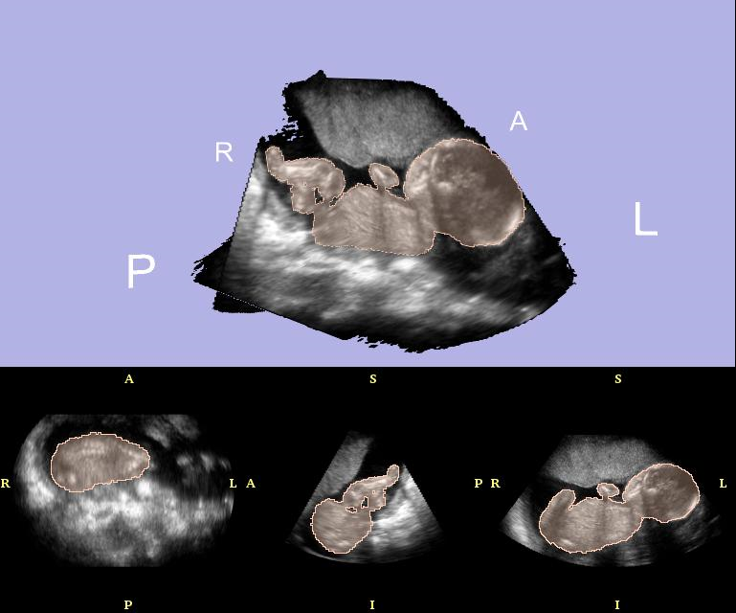
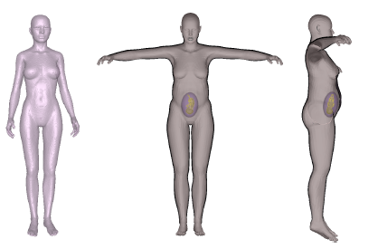
Research in Medical Imaging
Example: Fetal Imaging

Slide 9
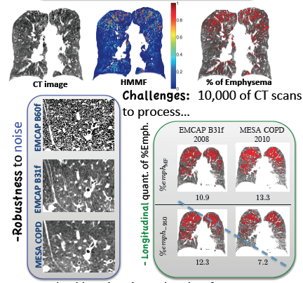
Research in Medical Imaging
Example: CT lung imaging

Slide 10
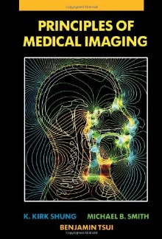
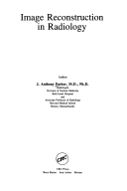


Books
Foundation of Medical Imaging, Z.H. Cho, J.P. Jones, M. Singh, John Wiley &Sons, Inc., New York 1993, ISBN 0-471-54573-2.
Principles of Medical Imaging, K.K. Shung, M.B. Smith, B. Tsui, Academic Press, San Diego 1992, ISBN 0-12-640970-6.
The Essential Physics of Medical Imaging (2nd Edition) ,Jerrold T. Bushberg, J. Anthony Seibert, Edwin M. Leidholdt Jr., John M. Boone, Lippincott Williams & Wilkins; 2nd edition, ISBN 0683301187.
Image Reconstruction in Radiology, J.A. Parker, CRS Press, Boca Raton, FL 1990, ISBN 0-8493-0150-5/90.

Slide 11
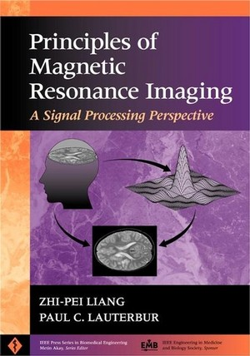
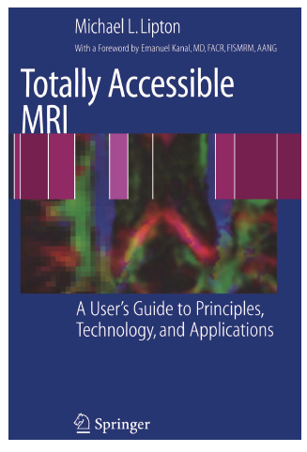
Books

